Slide 1
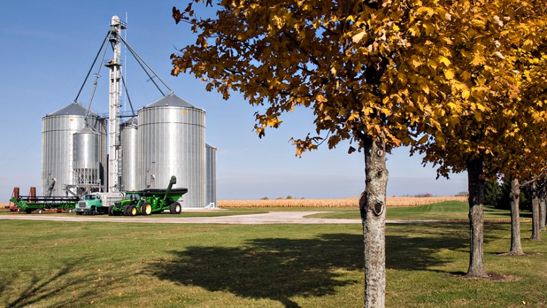


Statutory Public Meeting
December 16, 2021
Comprehensive Review & Five-Year Update
Township of Malahide Official Plan

Slide 2


Comprehensive Review & Update Statutory Public Meeting December 16, 2021
Township of Malahide Official Plan
What is a Comprehensive Review?
Purpose of the Meeting
The Planning Environment
Policy Review – OPA 20
Mapping Changes – OPA 20
Discussion
AGENDA

Slide 3
Statutory Public Meeting December 16, 2021
WHAT IS A COMPREHENSIVE REVIEW?
A review of an Official Plan that considers alternative directions for growth or development and determines how best to accommodate the development and provincial interests.
A Comprehensive Review considers:
  population and employment projections;
  evaluation of alternative directions for growth or development;
  opportunities to accommodate growth through intensification;
  physical constraints to accommodating the proposed development;
  planning for infrastructure and public service facilities including the ability to provide sewage and water services; and,
  cross-jurisdictional issues.
Comprehensive Review & Five-Year Update
Township of Malahide Official Plan

Slide 4
Statutory Public Meeting December 16, 2021
PURPOSE OF THE MEETING – WHAT AND WHY?
The Official Plan is the most important policy document in the provision and undertaking of public works.
The Township of Malahide has reviewed the findings and recommendations of the Background Report at its meeting on June 28, 2021 and is now in a position to move forward with an Amendment to the Official Plan to formally reflect those desired changes.
This meeting offers the opportunity for Council and the public to review the proposed changes to the Official Plan contained in Amendment No. 20.
Comprehensive Review & Five-Year Update
Township of Malahide Official Plan

Slide 5
Statutory Public Meeting December 16, 2021
PLANNING ENVIRONMMENT
The Official Plan in effect was adopted August 16, 2001 and approved by the Province on March 9, 2003.
The Official Plan must conform to the County of Elgin Official Plan and must be consistent with the Provincial Policy Statement (2020).
The Official Plan has been the subject of 19 amendments (not all of which were approved).
The Planning Act requires a Municipality to undertake a review of its Official Plan every five years. The last review was undertaken in 2013.
Comprehensive Review & Five-Year Update
Township of Malahide Official Plan

Slide 6
Comprehensive Review & Update Statutory Public Meeting December 16, 2021
Township of Malahide Official Plan
OFFICIAL PLAN AMENDMENT NO. 20
Updates Related to Current Projections & Planning Framework
Reflects the current situation and the most recent population projections to the year 2045.
Acknowledges the hierarchy of the County of Elgin Official Plan.
Re-iterates matters of Provincial Interest.
Updates policies related to Settlement Areas to mirror the policies in the 2020 Provincial Policy Statement

Slide 7
Comprehensive Review & Update Statutory Public Meeting December 16, 2021
Township of Malahide Official Plan
OFFICIAL PLAN AMENDMENT NO. 20
Cannabis Production and Processing
New section added to provide direction on the regulation of cannabis operations resulting from several inquiries received by the Township since the Federal government issued sweeping approvals for the industry.
Cannabis Production and Processing is proposed to be permitted in Agricultural and Industrial designations where it can be demonstrated by applicants that the use will be compatible with existing and planned surrounding land uses.

Slide 8
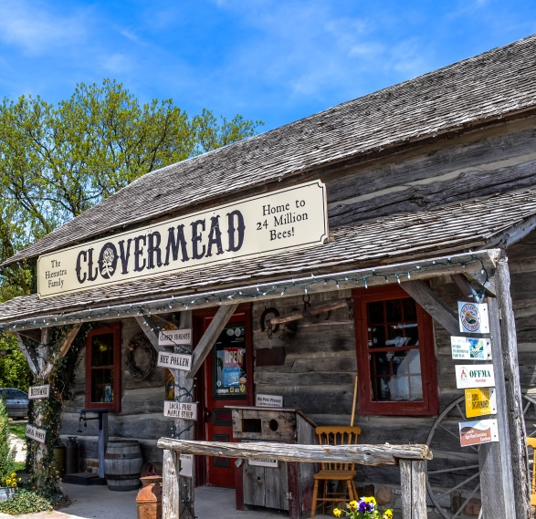
Comprehensive Review & Update Statutory Public Meeting December 16, 2021
Township of Malahide Official Plan
OFFICIAL PLAN AMENDMENT NO. 20
Rural & Agricultural Development
  On-Farm Diversified Uses (Section 2.1.4): provides the Township with greater flexibility when assessing the types of uses permitted and the standards applying to such uses.
  Second Dwelling Units (Section 2.1.13): permits a second dwelling unit within a single detached dwelling or within an accessory building on lands designated ‘Agriculture’. (The current OP policy (Section 4.1.5) only addresses and permits second dwelling units in designated settlement areas).
  Granny Flats (Section 3.9): policies added to permit granny flats or garden suites for family members. There is likely to be continued interest by property owners in the ability to provide for temporary accommodation for family members residing on the same lot in both agricultural and settlement areas.

Slide 9
Comprehensive Review & Update Statutory Public Meeting December 16, 2021
Township of Malahide Official Plan
OFFICIAL PLAN AMENDMENT NO. 20
Industrial Policies
3.4.1 Conversion of Employment Areas:
  Permits the conversion of employment areas outside a comprehensive review subject to sufficient planning justification being provided and as provided for under the PPS 2020 (Section 1.3.2.5).
3.4.5 Home Based Industrial Park:
  A new designation and policy is introduced to permit the development of home-based industrial parks following on a similar theme as the Silvermoon Innovation Park lying adjacent to Highway No. 401 in the Municipality of Thames Centre.

Slide 10
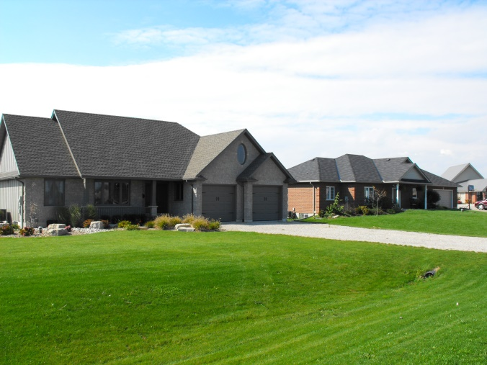
Comprehensive Review & Update Statutory Public Meeting December 16, 2021
Township of Malahide Official Plan
OFFICIAL PLAN AMENDMENT NO. 20
Future Urban Growth
A large amount of land is reallocated from unserviced, or partially serviced hamlet settlement areas to the Village of Springfield. A higher density of residential development is anticipated in Springfield due to the existing municipal sanitary services and planned extension of water services.
The ‘Future Urban Growth’ designation acknowledges that these lands will eventually be developed for urban land uses and provides a degree of flexibility insofar as it is difficult to forecast what the demand for residential development will be once full municipal services are available.
A number of factors are expected to accelerate demand for housing in Springfield. The Future Urban Growth designation will help the Township maintain flexibility to address these shifting trends.

Slide 11
Comprehensive Review & Update Statutory Public Meeting December 16, 2021
Township of Malahide Official Plan
OFFICIAL PLAN AMENDMENT NO. 20
Land Supply & Demand
Arising from the population projections and a detailed review of lands available for development, it has been determined that the Township has more than an adequate supply of land to accommodate future growth and anticipated housing needs.
In recognition that the Township does not require additional lands to accommodate growth, it is recommended that a focus be placed on ensuring that underutilized lands in the designated hamlets be “re-shuffled” and re-allocated to the Village of Springfield, where opportunities for growth are appropriately allocated. Key factors at play in determining the location of growth lands are related to:
  Geography
  Transportation Linkages
  Potential availability of full municipal services (water and sanitary)
  Opportunities for access to employment lands
County of Elgin has expressed support for the consolidation of developable lands within the Village of Springfield.

Slide 12
Comprehensive Review & Update Statutory Public Meeting December 16, 2021
Township of Malahide Official Plan
Malahide Official Plan Comprehensive Review & Update
Summary of Comments Received (since the Special Meeting of Council held on June 28, 2021)
Sent By | Date of Submission | Property Reference | Comment/Concern | Recommendation
Rosemary Kennedy | August 3, 2021 | 11184 Springfield Road Schedule ‘A’ of OPA 20 | Expressed some concerns with respect to the proposed ‘Industrial’ designation of the owner’s lands at the south end of Springfield. The Township has advised that the proposed change in land use designation from ‘Agriculture’ to ‘Industrial’ does not “force” the owner to develop. It simply directs how and where development of an area should occur in the future. | No Change Recommended
Tristan Balint | August 11, 2021 | 51048 Ron McNeil Line Schedule ‘A’ of OPA 20 | The owner’s property backs onto the newly residential designated lands (future subdivision proposed by V-Group). The owner is seeking information on the proposed plan, such as where roads would be built, number of homes proposed, and an estimated timeline for the development. The Township has responded that the it is anticipated that any development would be required to be on sanitary services and developed at an appropriate density to make effective and efficient use of those lands through a plan of subdivision or condominium. | No Change Recommended
Rob & Rose Anne Kuiper | August 11, 2021 | 6784 Hacienda Road Schedule ‘G’ of OPA 20 | Owners object to the removal of their lands from the Settlement Area of Luton. The owners have invested money in exploring the various options for development of the property. The owners previously obtained four severances from the subject lands to build single detached dwellings along Hacienda Road. A strip of land is reserved for future access to the rear lands. | Revised the ‘Settlement Area’ boundary on Schedule ‘G’ to include the subject lands.

Slide 13
Comprehensive Review & Update Statutory Public Meeting December 16, 2021
Township of Malahide Official Plan
Malahide Official Plan Comprehensive Review & Update
Summary of Comments Received (since the Special Meeting of Council held on June 28, 2021)
Sent By | Date of Submission | Property Reference | Comment/Concern | Recommendation
Civic Planning Solutions c/o Shackleton Auctions | August 23, 2021 | 51570 Lyons Line Schedule ‘N’ of OPA 20 | Shackleton Auctions is seeking to expand the existing auction establishment (as noted at the June 28 Meeting). The owners request a minor adjustment to the lands designated ‘Special Policy Area’ as reflected on Schedule ‘N’. The are of the lands designated would not change from the original proposal. | Boundary of the Special Policy Area has been revised to reflect the most current proposal.
Ian Cousins c/o Cram & Associates | September 27, 2021 | Part Lot 24, Con 7 South | Owners seeking a designation to permit commercial, commercial/industrial, and residential uses on a 20.2 ha (50 ac) agricultural parcel situated on the east side of Belmont Road north of Yorke Line abutting the Village of Belmont. Subsequent to submission, municipal staff had discussions with David Cousins and it is understood that the owner has no objection to the proposed Agricultural designation at this time. | No Change Recommended
Kelvin Saarloos & Dick Greenway | November 29, 2021 | 12044 Dorchester Road Schedule ‘F’ of OPA 20 | Concur with recommendation that the lands situated on the east side of Dorchester Road abutting Kingsmill Corners be designated as a home-based business industrial park, but are concerned about the boundary limits of Kingsmill Corners not being extended to include the entirety of the property within the settlement area boundary. It was noted at the June 28 meeting that the Kingsmill area was one of three potential locations for a Home-Based Industrial Park. Council will ultimately decide which location(s) will be considered for this purpose and the boundary limits will be finalized accordingly. | Revised ‘Settlement Area’ boundary on Schedule ‘F’ to include the entirety of the subject lands. Retain all three areas identified as ‘Home-Based Industrial Park’ on Schedule ‘A’ (Springfield), Schedule ‘F’ (Kingsmill Corners), and Schedule ‘L’ (Aylmer East).

Slide 14
Comprehensive Review & Update Statutory Public Meeting December 16, 2021
Township of Malahide Official Plan
Malahide Official Plan Comprehensive Review & Update
Summary of Comments Received (since the Special Meeting of Council held on June 28, 2021)
Sent By | Date of Submission | Property Reference | Comment/Concern | Recommendation
Lisa & Steve Holmes | December 9, 2021 | 12044 Dorchester Road Schedule ‘F’ of OPA 20 | Owners reside at 48299 Ron McNeil Line and are opposed to the lands situated to the west of 12044 Dorchester Road being changed from ‘Agriculture’ to ‘Home-Based Business Industrial Park’. The owners have raised environmental concerns relating to Catfish Creek and wildlife in the area, as well as concerns that the land in question comprises good farmland. | The ‘Settlement Area’ be extended to include the subject lands as part of the ‘Home-Based Industrial Park’ designation.
Will Hayhoe (Hayhoe Homes) | December 9, 2021 | Schedule ‘A’ of OPA 20 | Supports direction of growth and development to the Village of Springfield on full municipal services. | N/A
Doug Tarry | December 1, 2021 | Schedule ‘A’ of OPA 20 | Supports provision of municipal water supply to the Village of Springfield. | N/A

Slide 15
Comprehensive Review & Update Statutory Public Meeting December 16, 2021
Township of Malahide Official Plan
OFFICIAL PLAN AMENDMENT NO. 20
MAPPING CHANGES

Slide 16
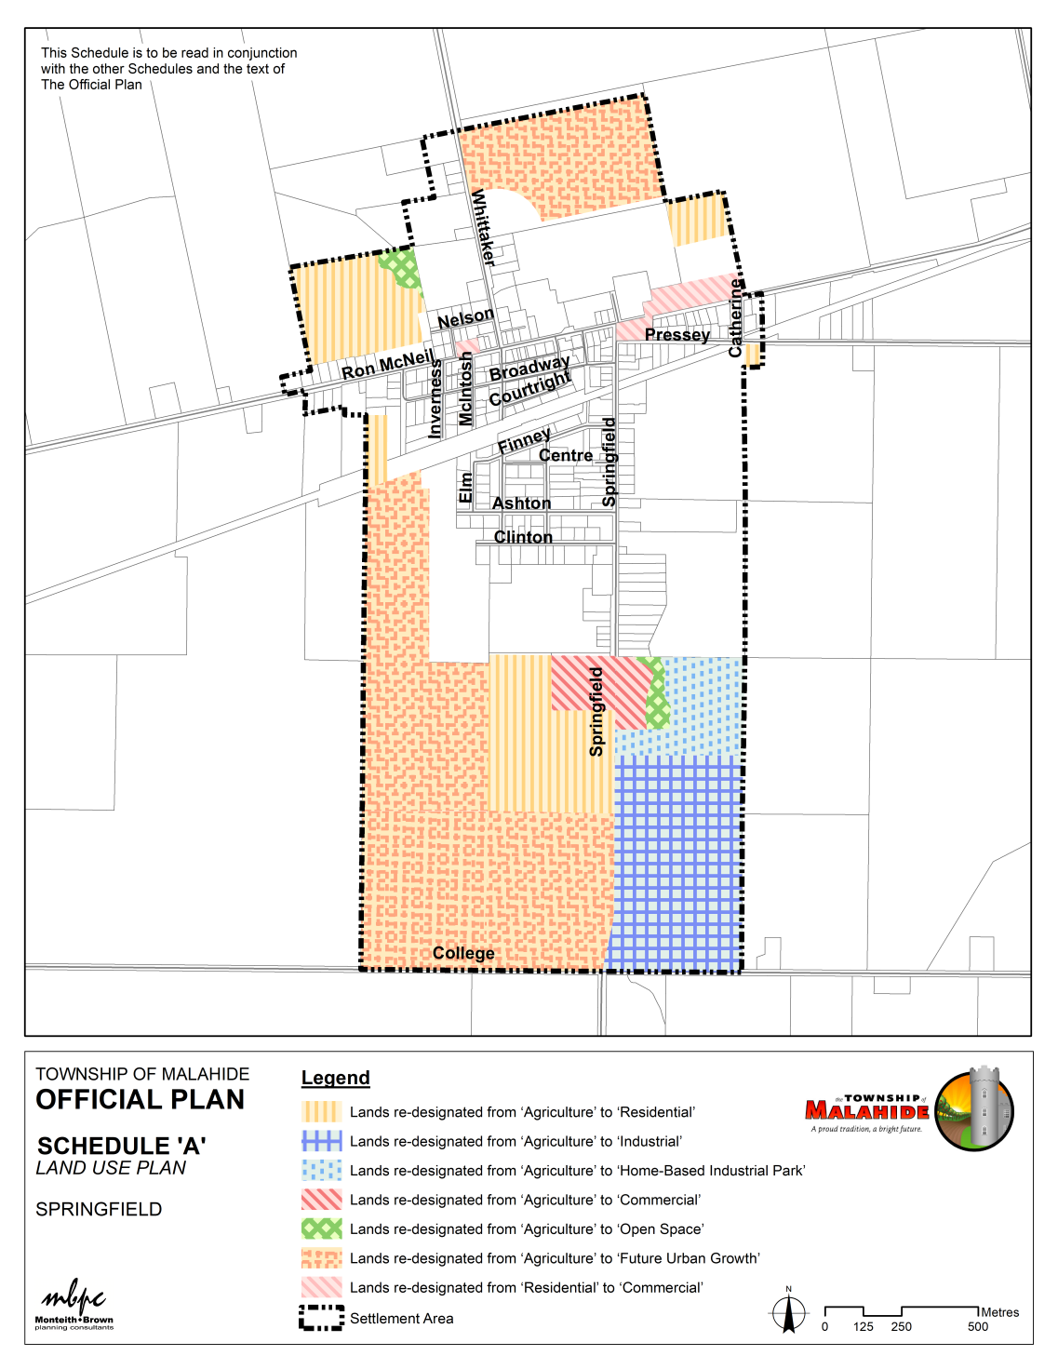
Comprehensive Review & Update Statutory Public Meeting December 16, 2021
Township of Malahide Official Plan
OPA NO. 20
SCHEDULE ‘A’
Village Settlement Areas - Springfield

Slide 17
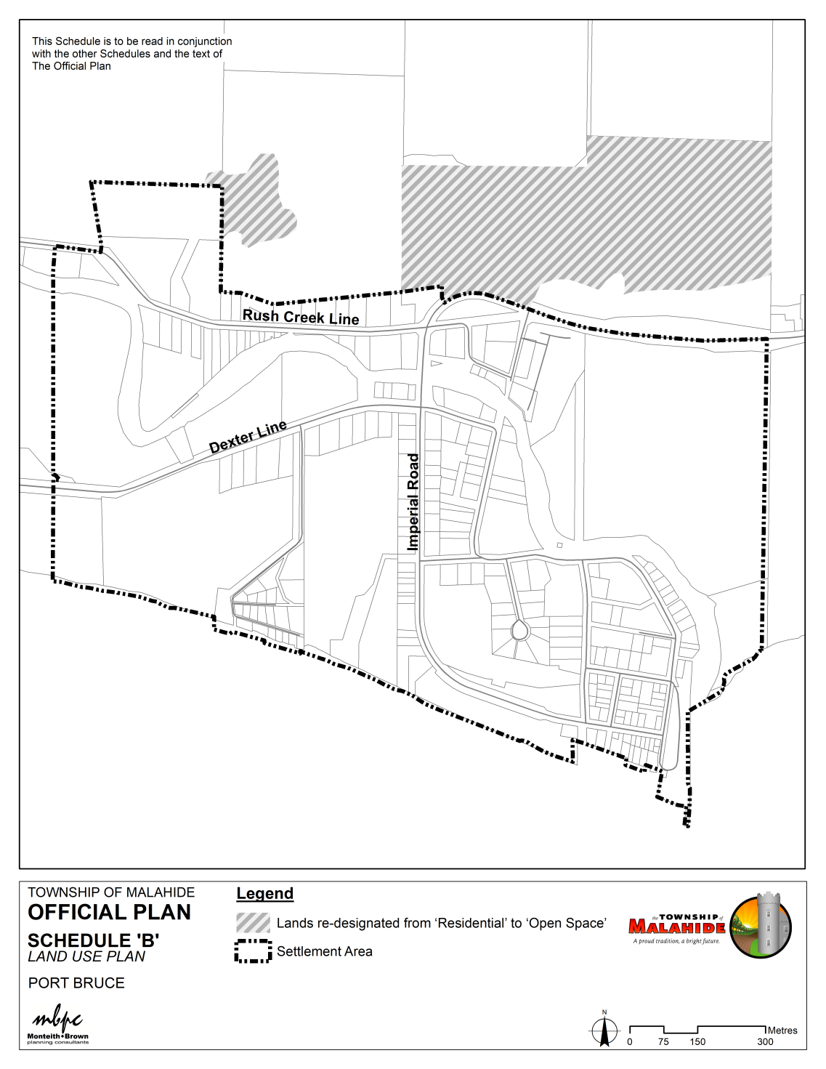
Comprehensive Review & Update Statutory Public Meeting December 16, 2021
Township of Malahide Official Plan
OPA NO. 20
SCHEDULE ‘B’
58.9 ha
Village Settlement Areas – Port Bruce

Slide 18
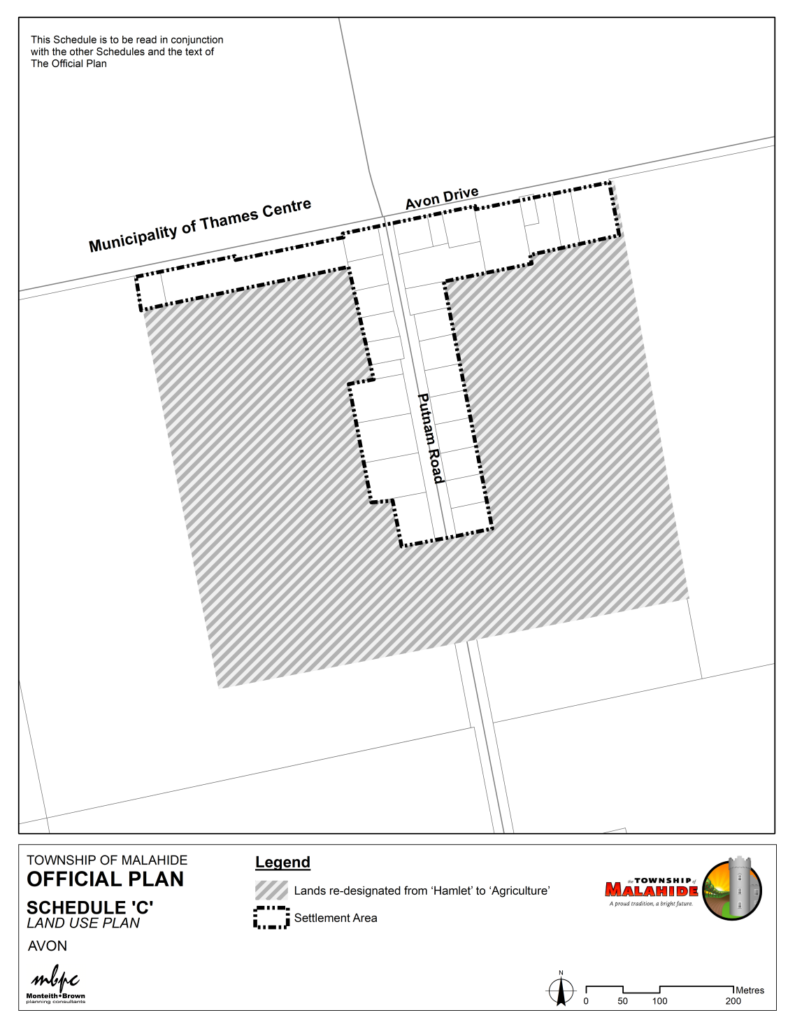
Comprehensive Review & Update Statutory Public Meeting December 16, 2021
Township of Malahide Official Plan
OPA NO. 20
SCHEDULE ‘C’
Hamlet Settlement Areas – Avon
26.8 ha

Slide 19
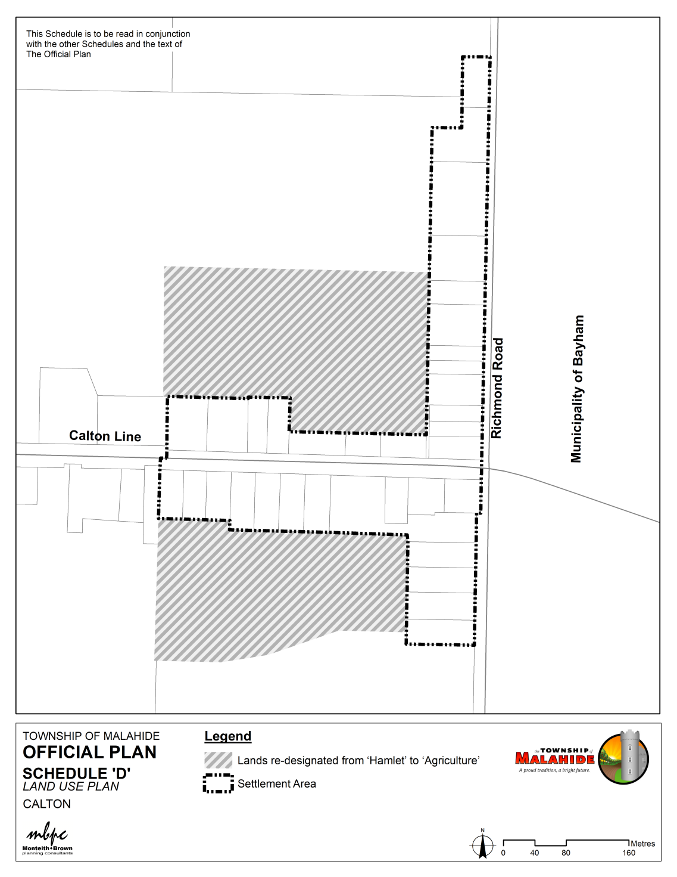
Comprehensive Review & Update Statutory Public Meeting December 16, 2021
Township of Malahide Official Plan
OPA NO. 20
SCHEDULE ‘D’
Hamlet Settlement Areas – Calton
11.2 ha

Slide 20
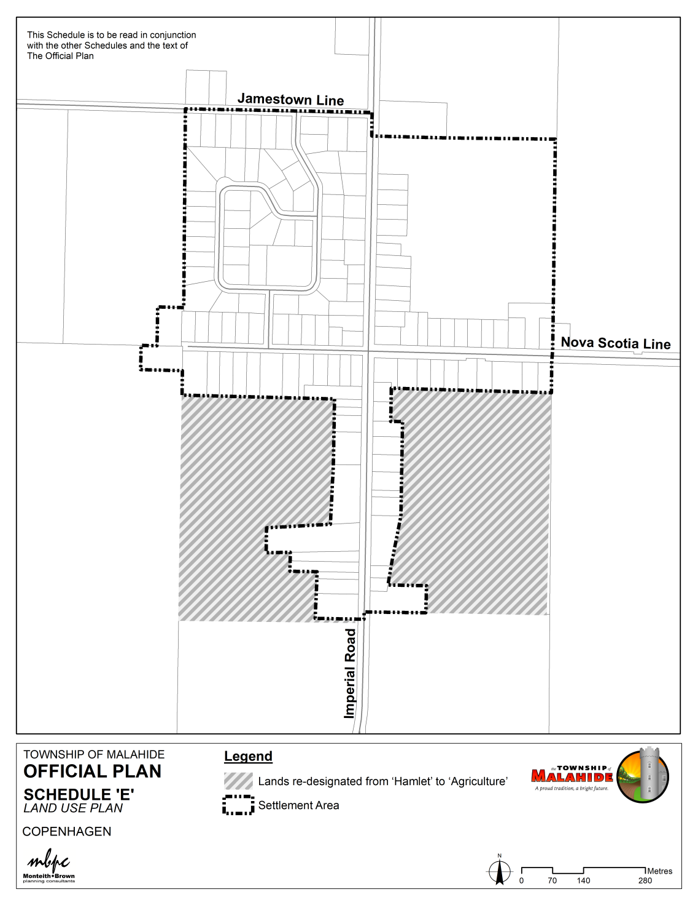
Comprehensive Review & Update Statutory Public Meeting December 16, 2021
Township of Malahide Official Plan
OPA NO. 20
SCHEDULE ‘E’
Village Settlement Areas – Copenhagen
32.8 ha

Slide 21
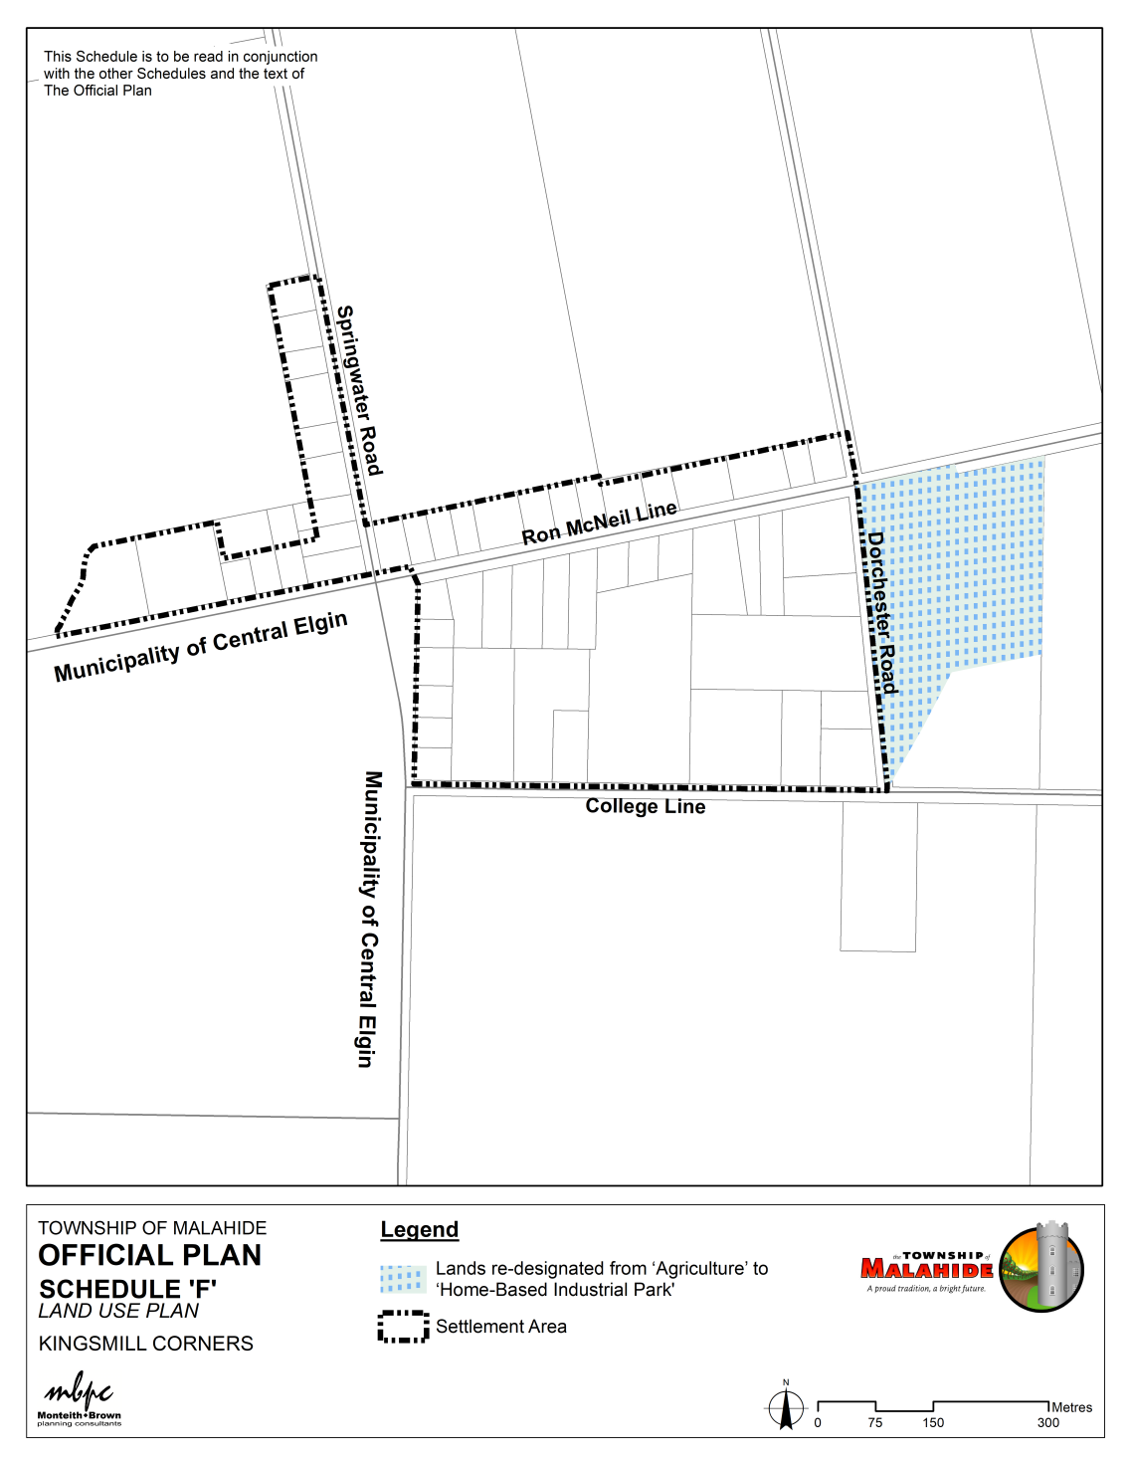
Comprehensive Review & Update Statutory Public Meeting December 16, 2021
Township of Malahide Official Plan
OPA NO. 20
SCHEDULE ‘F’
Village Settlement Areas – Kingsmill Corners
OPA 20 Schedule ‘F’ as circulated. Based on further submissions, it is recommended that the Settlement Area boundary be extended to include these lands.

Slide 22
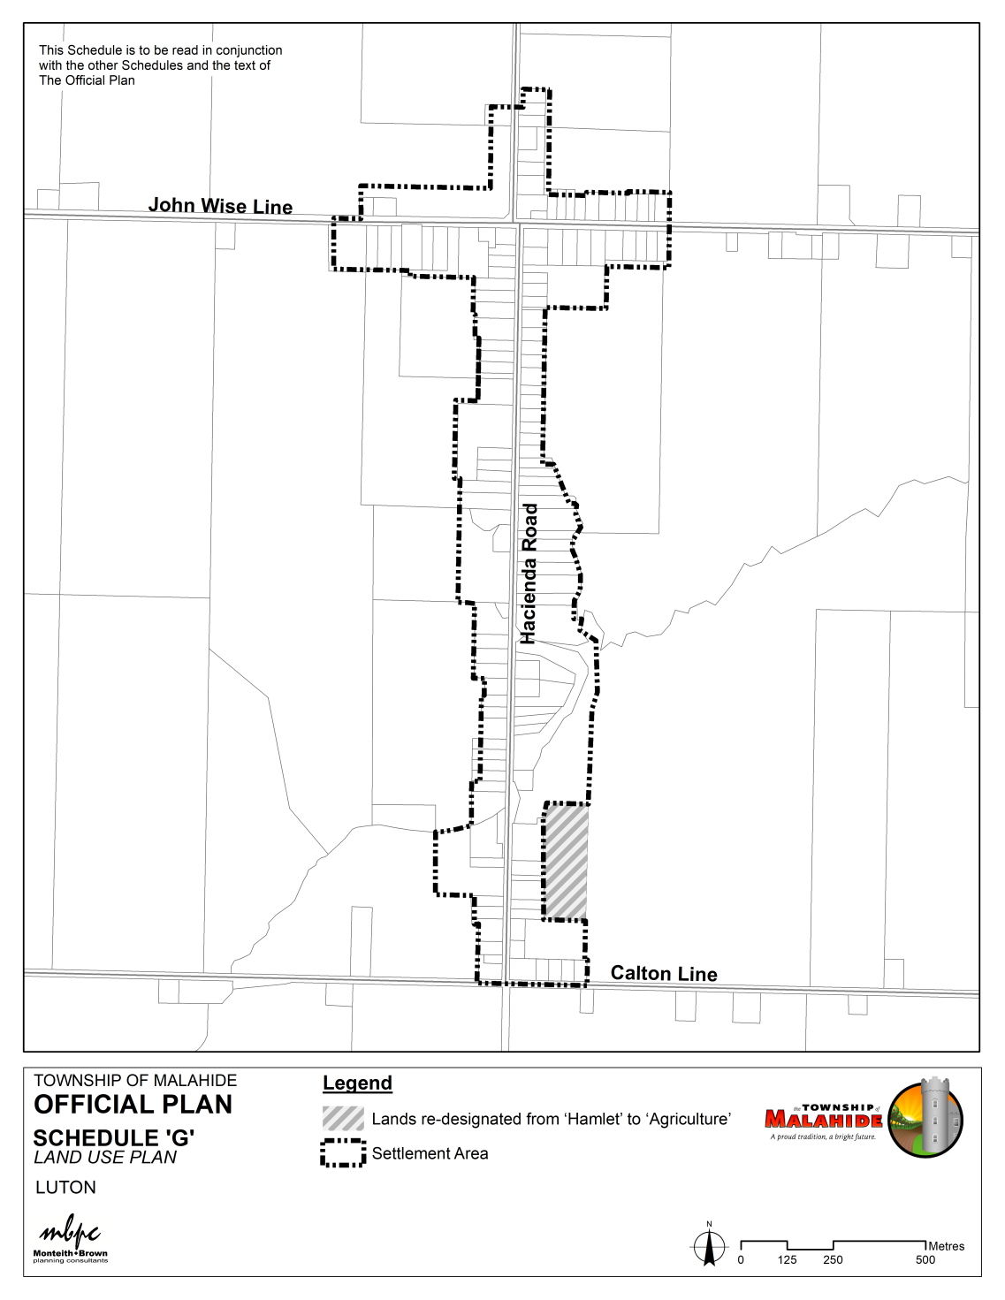
Comprehensive Review & Update Statutory Public Meeting December 16, 2021
Township of Malahide Official Plan
OPA NO. 20
SCHEDULE ‘G’
OPA 20 Schedule ‘G’ as circulated. Based on further submissions, it is recommended that the lands
remain in the Settlement Area
boundary
Village Settlement Areas – Luton
3.7 ha
3.7 ha

Slide 23
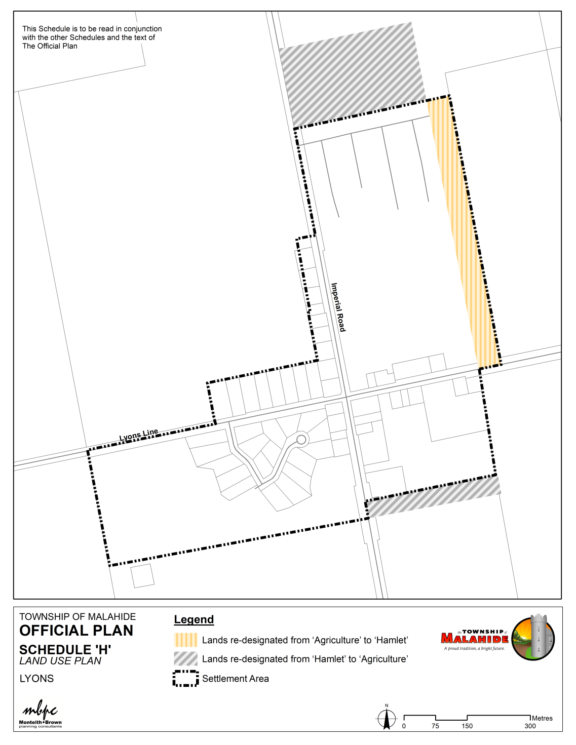
Comprehensive Review & Update Statutory Public Meeting December 16, 2021
Township of Malahide Official Plan
OPA NO. 20
SCHEDULE ‘H’
7.6 ha
Village Settlement Areas – Lyons

Slide 24
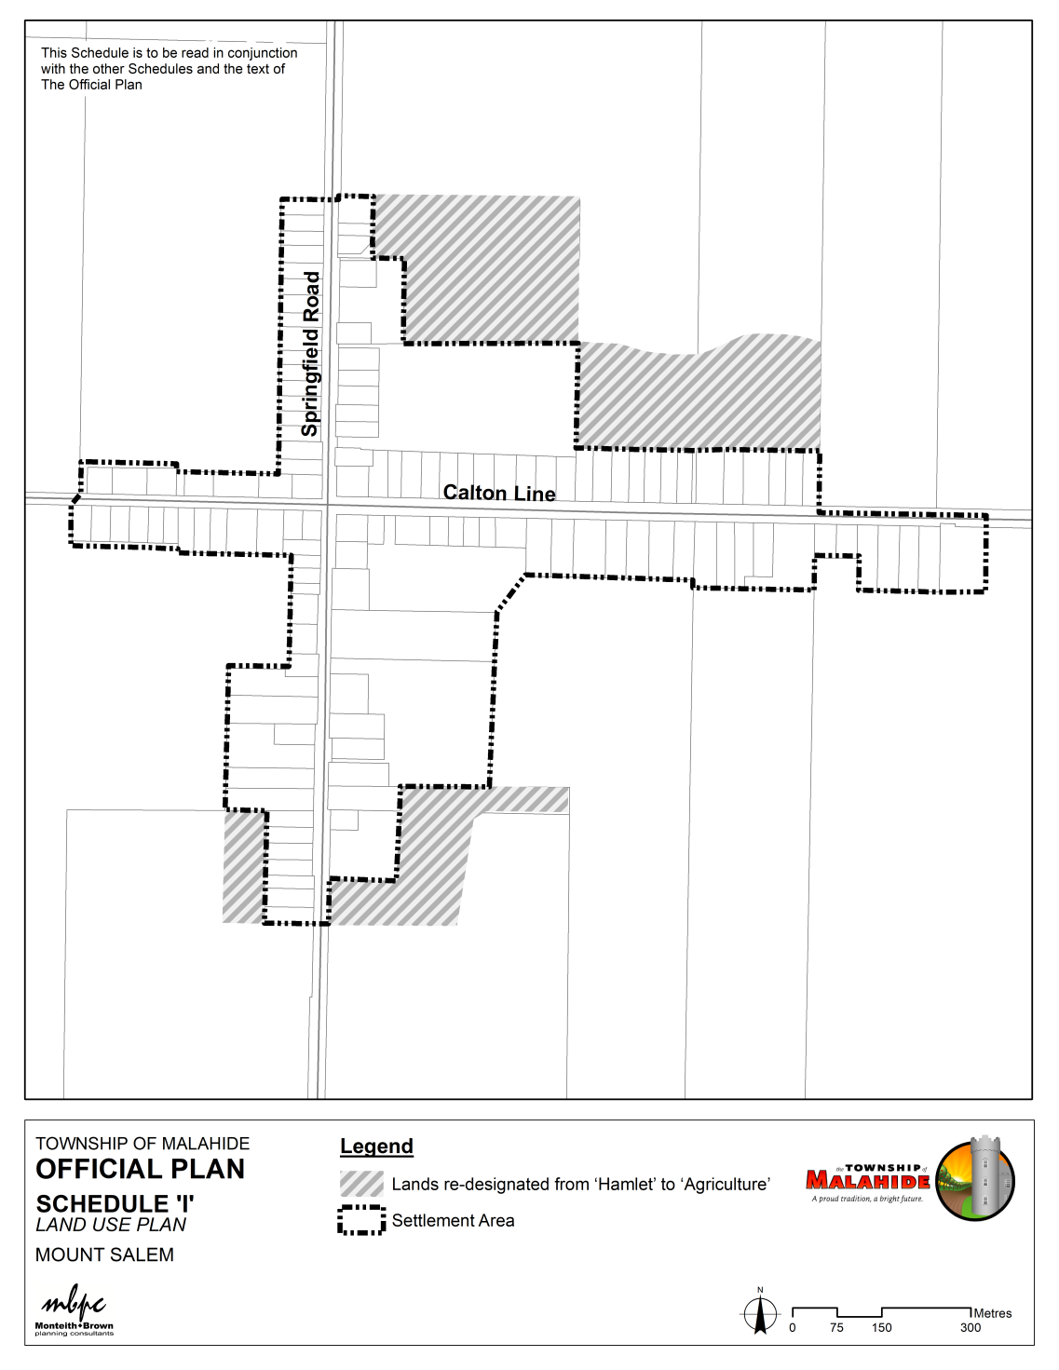
Comprehensive Review & Update Statutory Public Meeting December 16, 2021
Township of Malahide Official Plan
OPA NO. 20
SCHEDULE ‘I’
Village Settlement Areas – Mount Salem
20.9 ha

Slide 25
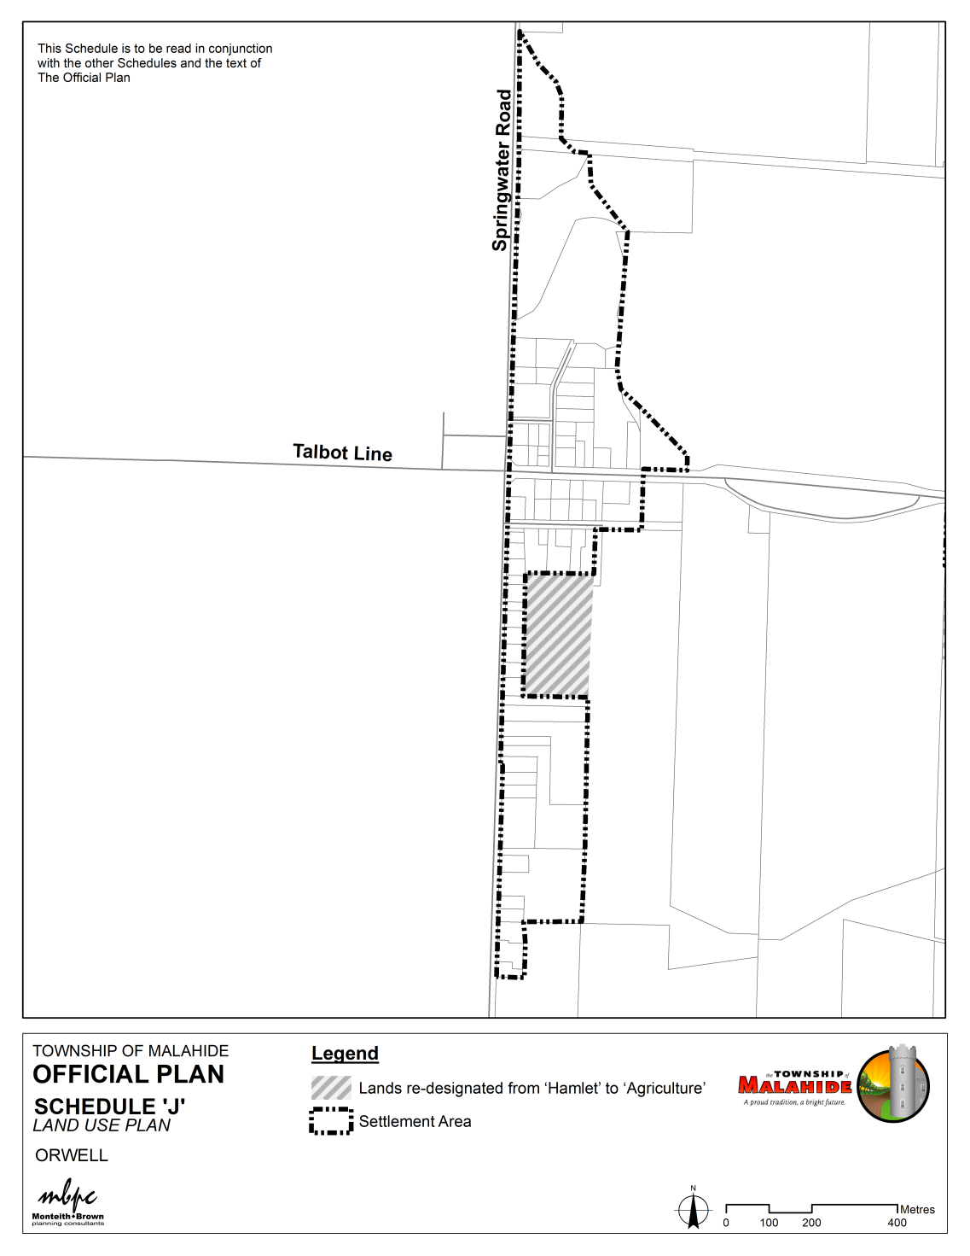
Comprehensive Review & Update Statutory Public Meeting December 16, 2021
Township of Malahide Official Plan
OPA NO. 20
SCHEDULE ‘J’
Village Settlement Areas –Orwell
4.6 ha

Slide 26
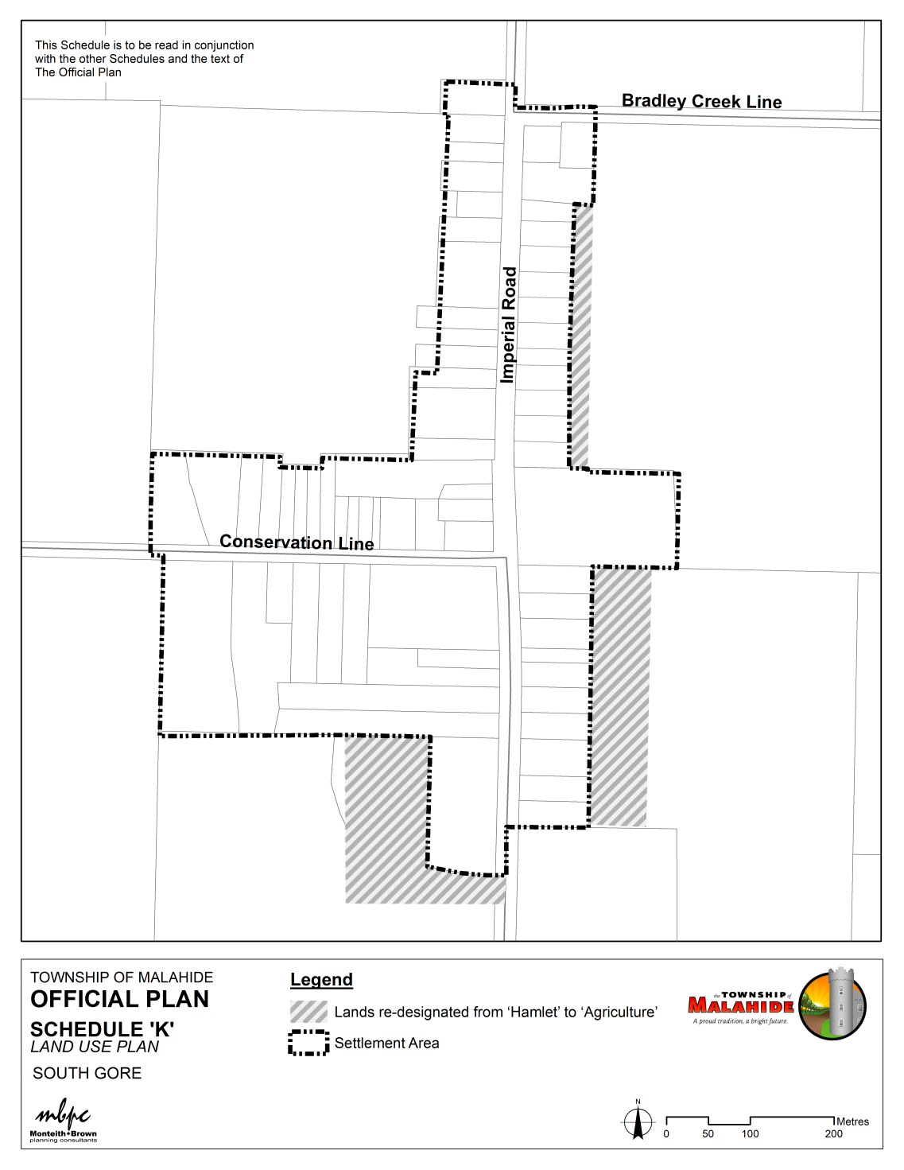
Comprehensive Review & Update Statutory Public Meeting December 16, 2021
Township of Malahide Official Plan
OPA NO. 20
SCHEDULE ‘K’
Village Settlement Areas –South Gore
2.9 ha

Slide 27
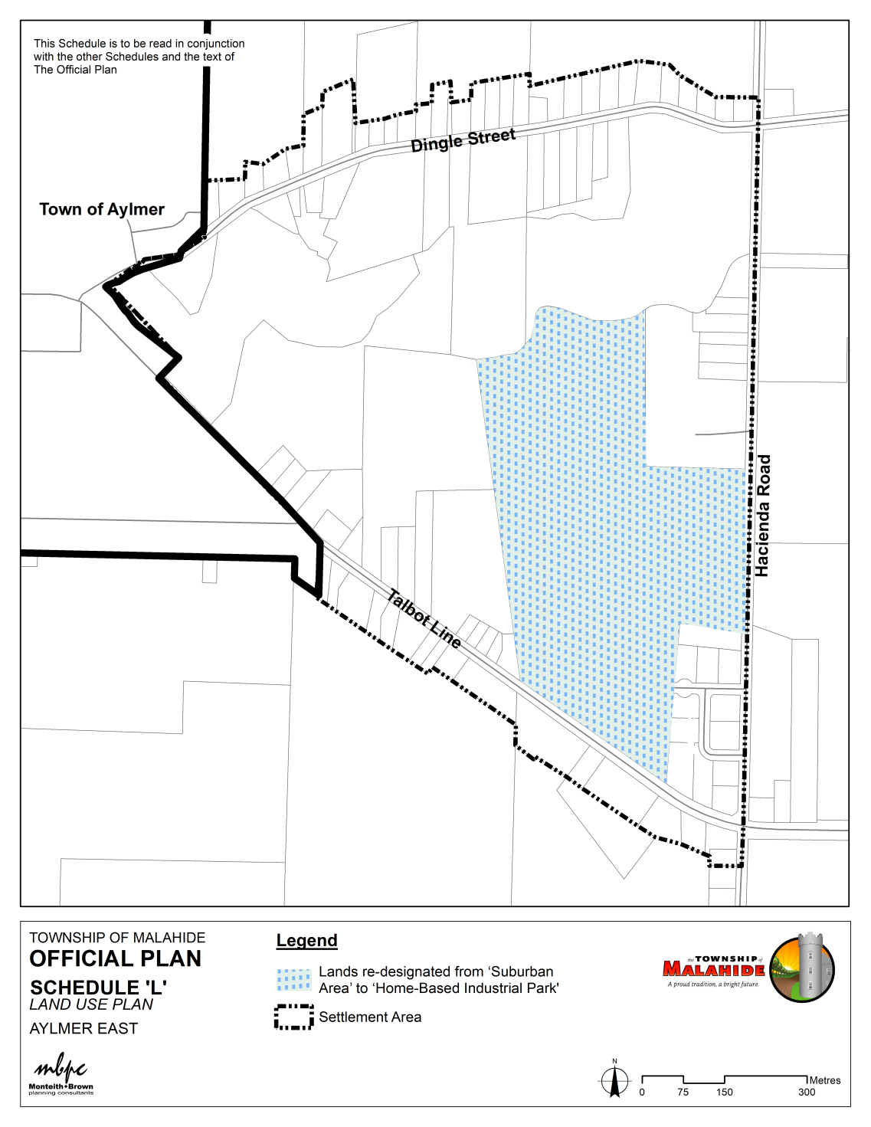
Comprehensive Review & Update Statutory Public Meeting December 16, 2021
Township of Malahide Official Plan
OPA NO. 20
SCHEDULE ‘L’
Suburban Settlement Areas –Aylmer East

Slide 28
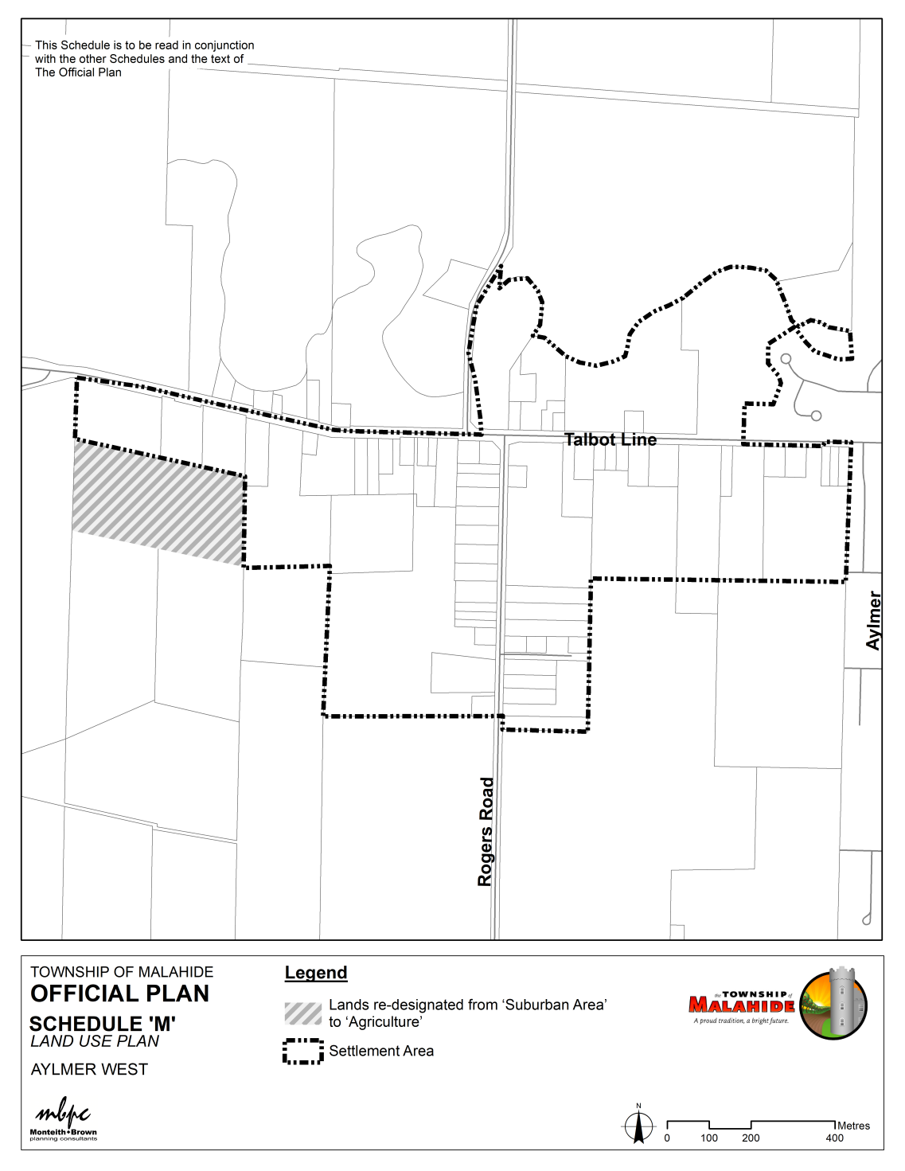
Comprehensive Review & Update Statutory Public Meeting December 16, 2021
Township of Malahide Official Plan
OPA NO. 20
SCHEDULE ‘M’
Suburban Settlement Areas –Aylmer West
8.9 ha

Slide 29
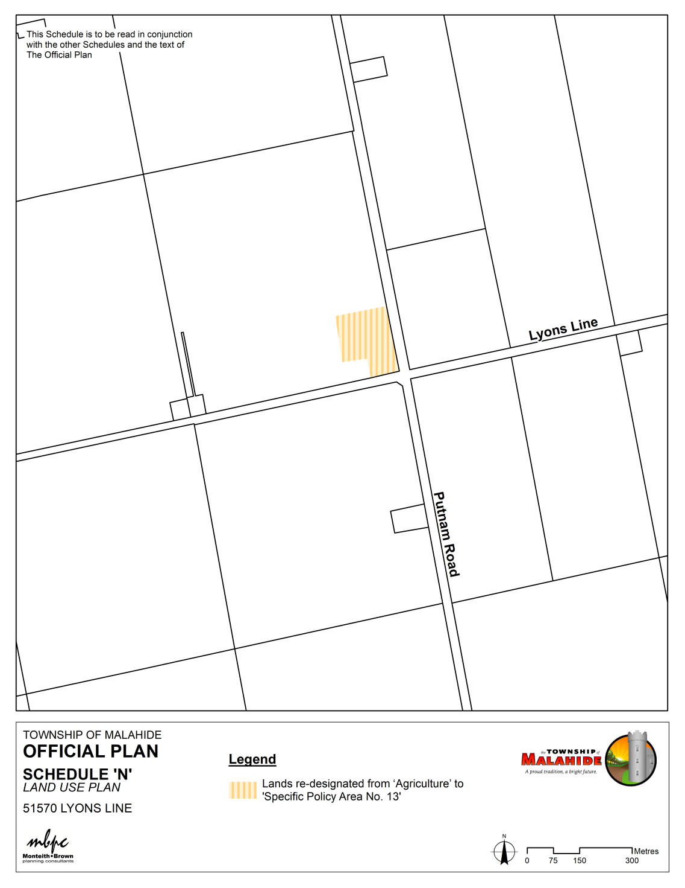
Comprehensive Review & Update Statutory Public Meeting December 16, 2021
Township of Malahide Official Plan
OPA NO. 20
SCHEDULE ‘N’
Site-Specific Areas –
51570 Lyons Line

Slide 30
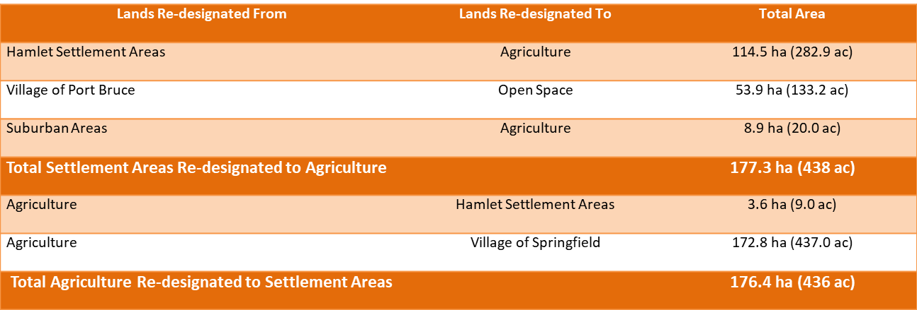
Comprehensive Review & Update Statutory Public Meeting December 16, 2021
Township of Malahide Official Plan
Official Plan Amendment No. 20 Mapping
Overview of Recommended Changes to Settlement Areas

Slide 31


Discussion

Slide 32
THANK YOU!

